Slide 1

INSTITUTE - UIE
DEPARTMENT- ACADEMIC UNIT-2
Bachelor of Engineering (Computer Science & Engineering)
Subject Name: Introduction to Problem Solving
Code:22CSH-101
Decision control structures in C
DISCOVER . LEARN . EMPOWER

Slide 2

OBJECTIVES
The course aims to provide exposure to problem solving with programming
The course aims to raise the programming skills of students via logic building capability
With the knowledge of C language students would be able to model real world problems
OBJECTIVES

Slide 3



Course Outcomes
CO Number | Course Outcome
CO1 | Remember the concepts related to fundamentals of C language, draw flowcharts and write algorithm/pseudocode.
CO2 | Understand the way of execution and debug programs in C language.
CO3 | Apply various constructs, loops, functions to solve mathematical and scientific problem.
CO4 | Analyze the dynamic behavior of memory by the use of pointers.
CO5 | Design and develop modular programs for real world problems using control structure and selection structure.

Slide 4
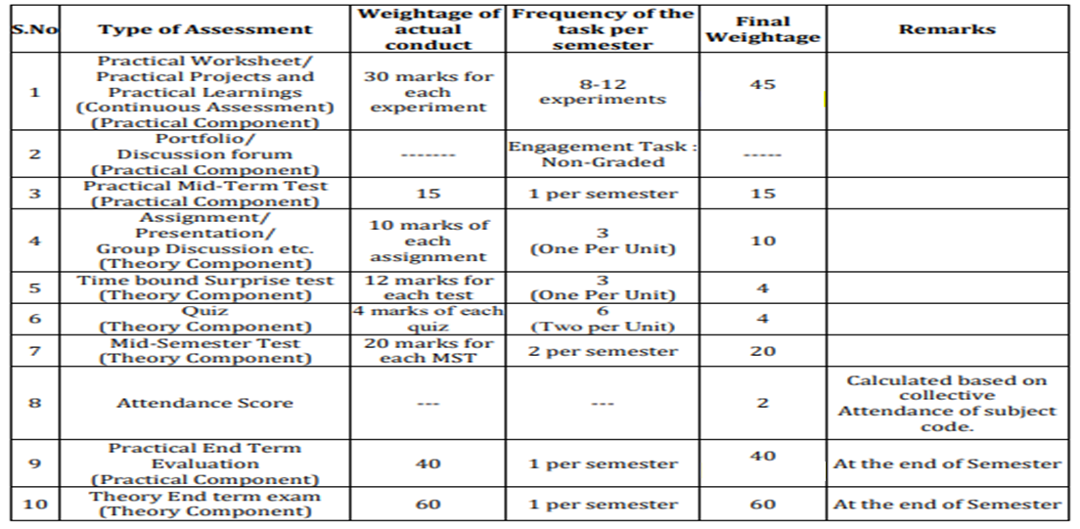
COURSE
SCHEME

Slide 5
WHY DECISION STATEMENTS ?
If we code a program sometimes, we need to control the execution of our program. For controlling the execution of the program we need decision control statements in c.
WHEN AND HOW DECISION STATEMENTS ?
There will be many situations when you will be given two or more options and you will have to select an option based on the given conditions.
WHY ?
WHEN ?
HOW ?

Slide 6
RESOURCES & LEARNING DIRECTIONS
A WALK-THROUGH
To one of the real world example where decision statements are used.
To all the decision control statements
To decision control syntax and examples
To implementation of decision control structures
LEARNING DIRECTIONS
Based on knowledge received, a learner would be able to identify the scenarios where the control structures best suits according to need in the real world.

Slide 7
SHOPPING
Let us go through an….
EXAMPLE
Does all our daily tasks involves decision making ?
DID YOU LIKE THE BAG ?
YES
NO
YOU WILL PURCHASE
YOU WILL NOT PURCHASE

Slide 8
DECISION MAKING IN C
Decision making is about deciding the order of execution of statements
Based on certain conditions the order is decided
Sometimes we need to repeat a group of statements until certain specified conditions are met
DECISION MAKING STATEMENTS
If statement
goto statement
Switch
statement
Conditional operator statement (?:)

Slide 9
GENERAL FORM OF SIMPLE IF STATEMENT
if(expression)
{
Statement Inside // if true
}
Statement Outside // if false
REMEMBER
if expression is true, statement inside will be executed
if expression is false, statement outside will be executed
DECISION MAKING WITH
IF STATEMENT
An introduction to….
SIMPLE-IF

Slide 10
Let int x=5, int y=3
if (x>y)
{
print “x is greater”
}
print “y is greater”
Output : value of x which is 5
EXECUTING
SIMPLE IF
STATEMENT

Slide 11
GENERAL FORM OF IF ELSE STATEMENT
if(expression)
{
Statement 1 // if true
}
else
{
Statement 2 // if false
}
REMEMBER
if expression is true, statement 1 will be executed otherwise, statement 2
DECISION MAKING WITH
IF STATEMENT
An introduction to….
IF-ELSE

Slide 12
Let int x=5, int y=3
if (x<y)
{
print “y is greater”
}
else
{
print “x is greater”
}
Output : value of x which is 5
EXECUTING
IF-ELSE
STATEMENT

Slide 13
if(expression 1)
{
if(expression 2)
{
statement 1
}
else
{
statement 2
}
}
else
{
statement 3
}
DECISION MAKING WITH
IF STATEMENT
An introduction to….
NESTED IF-ELSE

Slide 14
Let int x=1, y=3, z=2
if (x>y)
{
if(x>z)
{
print “x is greater”
}
else
{
print “z is greater”
}
}
else
{
print “y is greater”
}
EXECUTING
NESTED IF-ELSE
STATEMENT

Slide 15
GENERAL FORM OF ELSE-IF LADDER STATEMENT
if(expression 1)
{
Statement 1
}
else if(expression 2)
{
Statement 2
}
else
{
Statement 3
}
DECISION MAKING WITH
IF STATEMENT
An introduction to….
ELSE-IF LADDER

Slide 16
Suppose a student samiksha scored 80% marks, store her percentage in “per” variable. Now display the grade obtained by her.
if(per>=90)
{
print “ GRADE A”
}
else if(per>=80)
{
print “GRADE B”
}
else
{
print “GRADE C”
}
EXECUTING
ELSE-IF LADDER
STATEMENT

Slide 17
1.
We learned how different types of decision making
Structures are used with respect to real world scenario
SUMMARY
2.
3.
Also, we learned how different types of decision making
Structures are build and are different from each other
A walkthrough to the implementation of decision making statements is done using compiler

Slide 18
FREQUENTLY ASKED QUESTIONS
THINK AND ANSWER BELOW QUESTIONS
Why decision making is important?
Take an example of real world scenario where you see decision making?
What are different Decision structures?
For multiple condition check which decision structure will be used according to you?
PROGRAMS
Write a C program to find maximum between two numbers.
Write a C program to check whether a number is divisible by 5 and 11 or not.
Write a C program to input any alphabet and check whether it is vowel or consonant.
Write a C program to check whether a year is leap year or not.
Write a C program to input angles of a triangle and check whether triangle is valid or not.

Slide 19
UTILISE YOUR KNOWLEDGE TO ANSWER
1. Which of the following are incorrect statements? If int a=10.
1) if( a==10 ) printf("IncludeHelp");
2) if( 10==a ) printf("IncludeHelp");
3) if( a=10 ) printf("IncludeHelp");
4) if( 10=a ) printf("IncludeHelp");
2. What will be the output of following program ?
int main()
{
int a=10;
if(10L == a)
printf("10L");
else if(10==a)
printf("10");
else
printf("0");
return 0;
}
Let us see how much you have learned from the lecture and how effectively you can apply your knowledge…!!

Slide 20
UTILISE YOUR KNOWLEDGE TO ANSWER
3. What will be the output of following program ?
int main()
{
int pn=100;
if(pn>20)
if(pn<20)
printf("Heyyyyy");
else
printf("Hiiiii");
return 0;
}
4. A zero value is considered to be false and a non-zero value is considered to be true. A. True
B. False
Let us see how much you have learned from the lecture and how effectively you can apply your knowledge…!!

Slide 21

DISCUSSION FORUM
Utilize your knowledge from what you have learned in decision making and think about what best contribution you can do to the real world making use of decision statements based on your requirement….
Post your comments about your ideas in the discussion forum.

Slide 22
REFERENCES
Reference Books
[1] Kanetkar, Y. (2010). Let us C. 15th ed.
[2] Thareja Reema (2014) Programming in C. 2nd ed.
[3] Zed A. Shaw, Learn C the Hard Way’
Reference Website
[1] “Programming Notes.” Yet Another Insignificant Programming Notes, www.ntu.edu.sg/home/ehchua/programming/.
[2] “Programming Notes.” Yet Another Insignificant Programming Notes, www.ntu.edu.sg/home/ehchua/programming/.
Online Courses
https://www.classcentral.com/course/swayam-introduction-to-programming-in-c-2486
https://www.coursera.org/learn/c-for-everyone
BOOKS
WEBSITES
COURSES

Slide 23

THANK YOU

